Slide 1

FACE ATTENDANCE SYSTEM at United College of Engineering and Research
Rishabh Pandey(2000100130107)
Siddharth Gupta(2000100130139)
Vijay Raj Singh(2000100130158)
Priyanshu Pandey(2000100130104)

Slide 2

Topics Covered
Introduction
Abstract
Motivation
Requirement
User Interface
Flowchart
Haar Cascade Algorithm
LBPH Algorithm
Detection and Recognition
Procedure
Reference
Conclusion

Slide 3
Introduction
The purpose of the attendance monitoring system using face recognition is to ease the attendance process which consumes lot of time and efforts , it is a convenient and easy way for students and teacher.

Slide 4
The system will capture the images of the students and using face recognition algorithm and mark the attendance in the sheet. This way the class-teacher will get their attendance marked without actually spending time in traditional attendance marking.

Slide 5
Abstract
In the era of modern technologies emerging at rapid pace there is no reason why a crucial event in educational sector such as attendance should be done in the old boring traditional way. Attendance monitoring system will save a lot of time and energy for the both parties students as well as the class teachers.

Slide 6
Attendance will be monitored by the face recognition algorithm by recognizing only the face of the students from the rest of the objects and then marking them as present. The system will be pre feed with the images of all the students and with the help of this pre feed data the algorithm will detect them who are present and match the features with the already saved images of them present in the database.

Slide 7
Motivation
Nowadays many educational institutes are using a manual monitoring system and most of the time they accidentally loss their attendance sheet so that they cannot properly monitor the attendance of their students .Therefore it is important to design software which will help these institutes to mark the attendance of the students by face recognition which will save their time.

Slide 8
Requirement
Minimum RAM: 256 MB
Hard Disk: 40 GB
Processor: Intel Pentium 4
Operating System: Windows OS, Linux OS, UNIX OS and Mac OS.

Slide 9
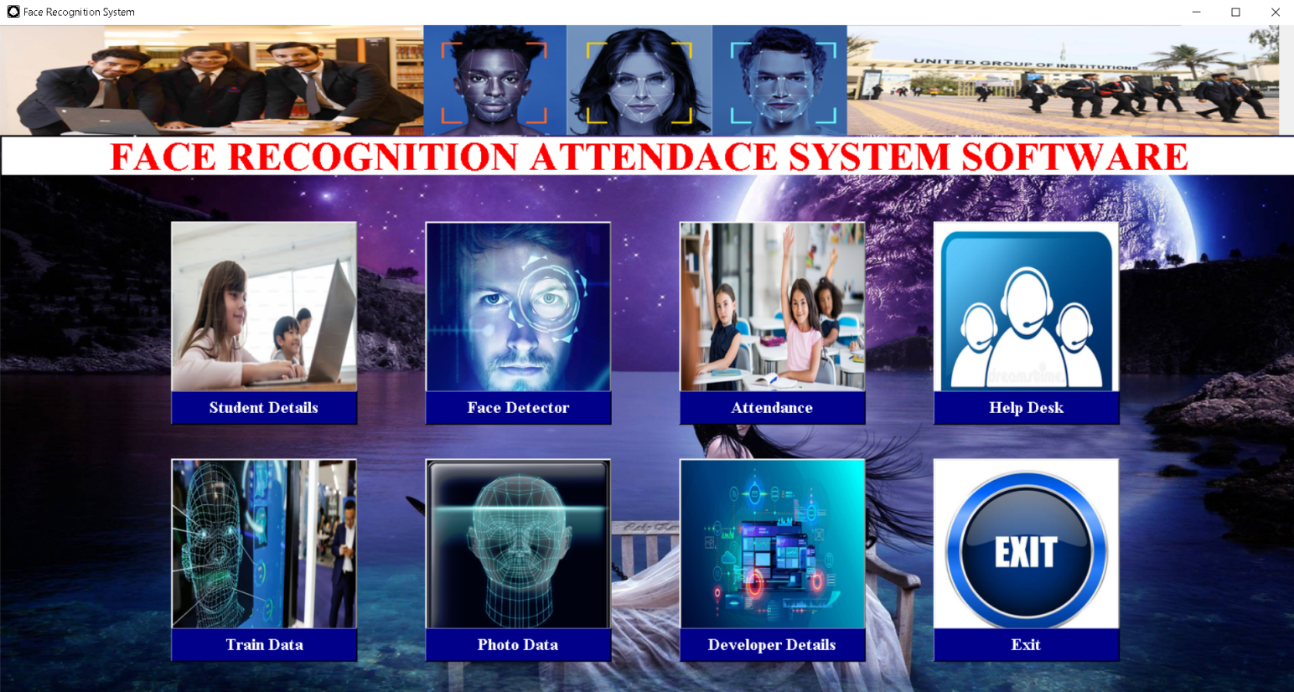
User Interface

Slide 10
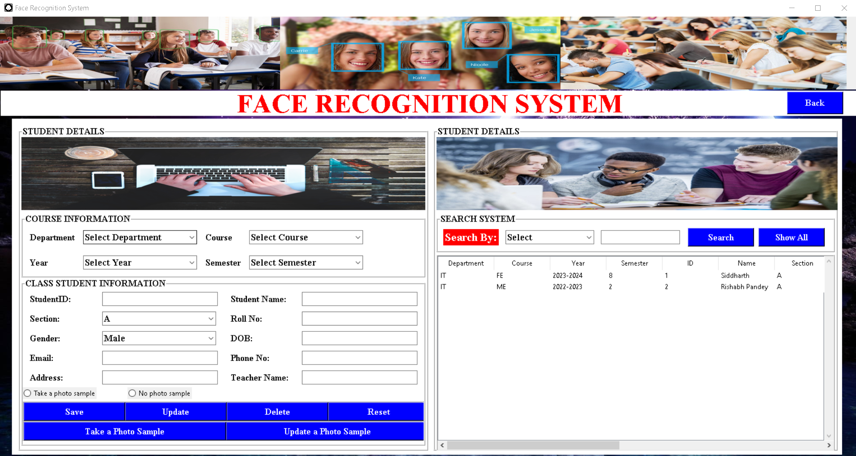

Slide 11
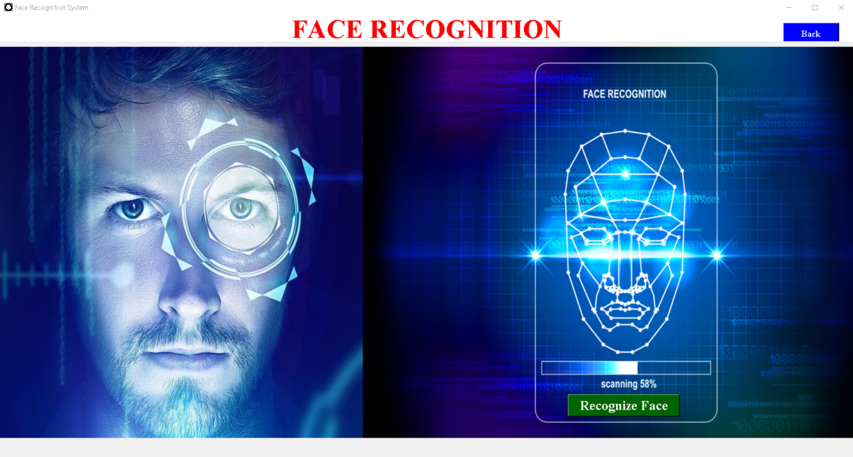

Slide 12
Flowchart
Add students information and face in database
Database is trained in backend
Open the camera for recognition
Face recognition done
Attendance with date and time saved in database

Slide 13
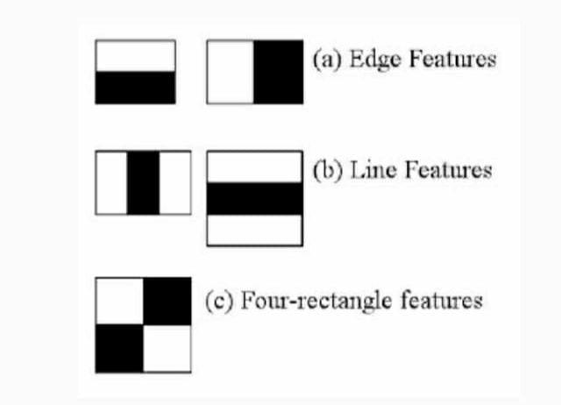
Haar Cascade Algorithm
It is an Object Detection Algorithm used to identify faces in an image or a real time.
The algorithm is given a lot of positive images consisting of faces, and a lot of negative images not consisting of any face to train on them.

Slide 14
LBPH Algorithm
The Local Binary Pattern Histogram(LBPH) algorithm is a simple solution on face recognition problem, which can recognize both front face and side face.
Local Binary Pattern (LBP) is a simple yet very efficient texture operator which labels the pixels of an image by thresholding the neighbourhood of each pixel and considers the result as a binary number.

Slide 15
Detection and Recognition
Face Detection: It has the objective of finding the faces (location and size) in an image and probably extract them to be used by the face recognition algorithm.
Face Recognition: with the facial images already extracted, cropped, resized and usually converted to grayscale, the face recognition algorithm is responsible for finding characteristics which best describe the image.

Slide 16
Procedure
Training the Algorithm: First, we need to train the algorithm. To do so, we need to use a dataset with the facial images of the people we want to recognize. We need to also set an ID (it may be a number or the name of the person) for each image, so the algorithm will use this information to recognize an input image and give you an output. Images of the same person must have the same ID.
Applying LBPH Algorithm: The first computational step of the LBPH is to create an intermediate image that describes the original image in a better way, by highlighting the facial characteristics. To do so, the algorithm uses a concept of a sliding window, based on the parameters radius and neighbors.

Slide 17
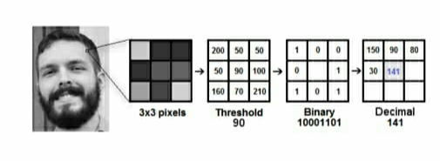

Slide 18
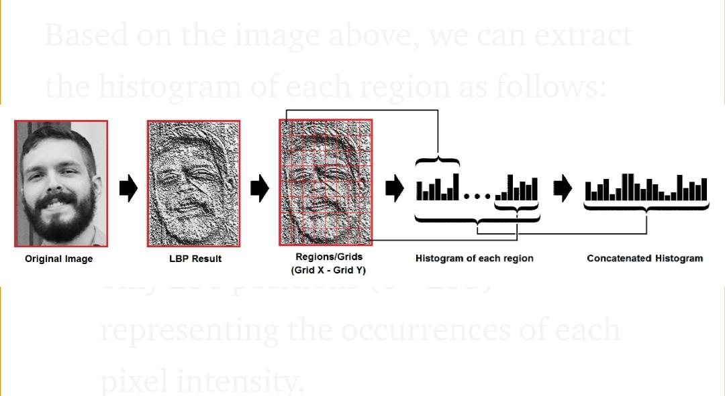
Extracting Histogram: Now, using the image generated in the last step, we can use the Grid X and Grid Y parameters to divide the image into multiple grids, as can be seen in the following image:

Slide 19
Performing the face recognition
In this step, the algorithm is already trained. Each histogram created is used to represent each image from the training dataset. So, given an input image, we perform the steps again for new image and creates a histogram which represents the image.

Slide 20
Advantage
It is trouble-free to use.
It is relatively a fast approach to enter attendance.
It is highly reliable.
Best user Interface.

Slide 21
Reference
http://www.wordpress.org/
http://www.academia.edu/
http://www.stackoverflow.com/
http://www.iproject.com

Slide 22
Conclusion
The Attendance Management System is developed using Machine Learning meets the objectives of the system which it has been developed.
The system has reached a steady state where all bugs have been eliminated. The system is operated at a high level of efficiency.
The system solves the problem.
It was intended to solve as requirement specification.

Slide 23
THANK YOU

